Slide 1
Introduction To devOps
Presented By : Pratiksha Sapkale

Slide 2
What is devOps ?
The DevOps is a combination of two words, one is software Development, and second is Operations.
This allows a single team to handle the entire application lifecycle, from development to testing, deployment, and operations.
DevOps helps us to reduce the disconnection between software developers, quality assurance (QA) engineers, and system administrators.

Slide 3
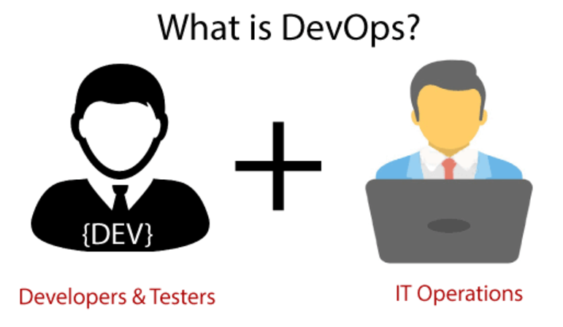
DevOps Promotes Collaboration Between Development And Operations Team To Deploy Code To Production Faster In An Automated & Repeatable Way.
DevOps can also be defined as a sequence of development and IT operations with better communication and collaboration.

Slide 4
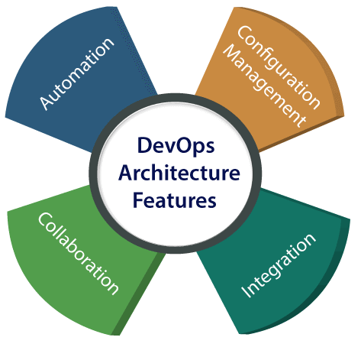
DevOps Architecture Features

Slide 5
1) Automation :
Automation can reduce time consumption, especially during the testing and deployment phase.
The productivity increases, and releases are made quicker by automation.
This will lead in catching bugs quickly so that it can be fixed easily.
2) Collaboration :
The Development and Operations team collaborates as a DevOps team.
DevOps team improves the cultural model as the teams become more productive with their productivity, which strengthens accountability and ownership.
The teams share their responsibilities and work closely in sync, which in turn makes the deployment to production faster.

Slide 6
3) Integration :
Applications need to be integrated with other components in the environment.
The integration phase is where the existing code is combined with new functionality and then tested.
Continuous integration and testing enable continuous development.
The frequency in the releases and micro-services leads to significant operational challenges.
To overcome such problems, continuous integration and delivery are implemented to deliver in a quicker, safer, and reliable manner.

Slide 7
4) Configuration management :
It ensures the application to interact with only those resources that are concerned with the environment in which it runs.
The configuration files are not created where the external configuration to the application is separated from the source code.
The configuration file can be written during deployment, or they can be loaded at the run time, depending on the environment in which it is running.

Slide 8
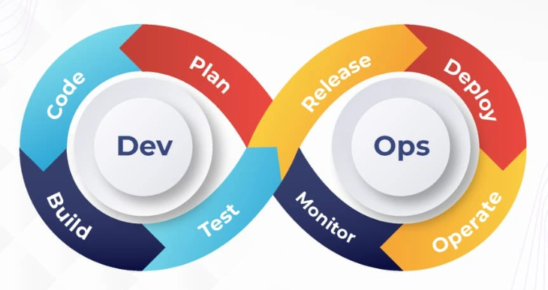
DevOps Lifecycle PHASES

Slide 9
The DevOps lifecycle includes seven phases as given below:
Plan: Define requirements and goals.
Develop: Code and build the application.
Build: Compile and package the application.
Test: Automated and manual testing for quality assurance.
Release: Prepare the application for deployment.
Deploy: Deliver to production environments.
Operate: Monitor and maintain performance.
Monitor: Real-time feedback and analytics to improve

Slide 10
Benefits of DevOps :
1) Accelerated delivery of features
2) Enhanced operational efficiency
3) Reduced downtime and recovery time
4) Improved scalability and security
5) Better alignment with business goals

Slide 11
Real-Life Use Cases
Netflix: Continuous delivery for frequent updates.
Amazon: Automated infrastructure scaling and deployment.
Etsy: Rapid deployments and recovery using monitoring tools.

Slide 12
Conclusion :
DevOps bridges the gap between development and operations, enabling faster, more reliable software delivery.
It fosters a culture of collaboration and continuous improvement, essential for staying competitive in today’s tech landscape.

Slide 13
Thank You !

